Slide 1

Exercises 101
Pat Anders
Manager, Health Emergency Preparedness Exercises
Patricia.anders@health.ny.gov

Slide 2



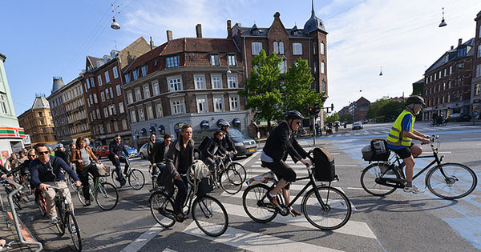
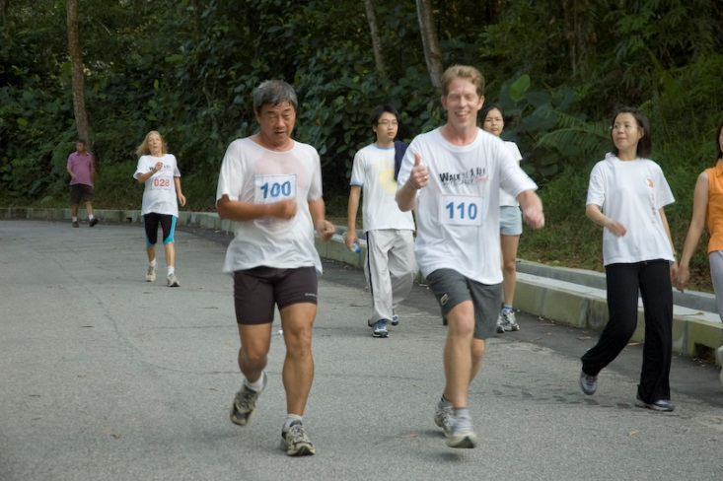

What Do You Think of When You Hear the Word Exercise?

Slide 3
Today we are going to talk about another type of exercise

Slide 4
What is a preparedness exercise?
An exercise is a simulated emergency, in which members of various agencies perform the tasks that would be expected of them in a real emergency.
In other words, an exercise should be a rehearsal for reality. Reality has a tendency to expose all weaknesses at a time when you can‘t afford to have any!

Slide 5
Why exercise?
Focuses team on responding to an emergency plan
  Validates the plan
  Provides opportunities to practice response in preparation for real events
Benefits
  Excellent training opportunity
  Better response over time
  Decreases anxiety for subsequent exercises or real events
  Positive outcomes more likely

Slide 6
Why are exercises so important?
Exercises are an essential component of an emergency preparedness program
Three main functions:
  Validation
    Validate plans, protocols, and procedures;
    Test recently changed procedures or plans
  Training
    Develop staff competencies;
    Practice in carrying out their roles in the plans;
    Assess and improve performance

Slide 7
Why are exercises so important?
Exercises are an essential component of an emergency preparedness program
Three main functions:
  Testing
    Test well-established procedures;
    Reveal gaps that may exist
    Increase awareness and understanding of hazards and potential impacts of those hazards
    Assess capabilities of existing resources and identify needed resources

Slide 8
Emergency Plans
Exercises should test existing plans with the overarching goals of
  Process improvement;
    Obtain participant feedback and recommendations for program improvement
  Measure improvement compared to objectives;
  Enhance responder’s capabilities and coordination among internal and external teams, organizations, and other entities
Exercise participants should be trained on the
plan prior to exercising

Slide 9

No one wants to be caught unprepared when an emergency strikes. We all want to be “ready to go” at a moment‘s notice.
Remember the old saying about how the only way to get to Carnegie Hall is through practice… practice….. practice.….?

Slide 10
Practice makes perfect
Testing your emergency plan, equipment, processes, and procedures uses the same principle!
  Give team members opportunities to practice
  Enhances teamwork
  Encourages the interaction and cooperation needed when a real emergency occurs.

Slide 11
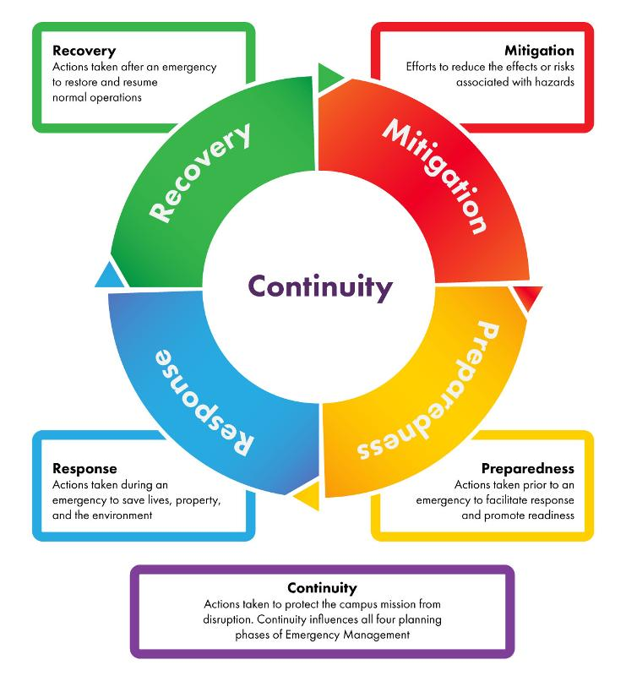
Mission Areas

Slide 12
Five Mission Areas of Emergency Preparedness
Mitigation/Prevention
  Activities performed in advance to lessen the severity and impact of an emergency.
Preparedness
  Activities performed in advance to reduce or eliminate hazards.
Notes:
Mitigation
Creating mutual aid agreements with neighboring communities or facilities to meet emergency response needs
Drilling redundant communications methods with the fire department
Moving generators out of basements or flood-prone areas
Facility wired to receive a back-up generator (“quick connect” agreements with power company)
Prevention
Isolation-based practices to prevent organism transmission to unaffected patients
Assessing residents or patients’ need for flu or pneumococcal vaccinations
Preparedness
Development of emergency management plans (e.g., evacuation, sheltering in place)
Stockpiling resources (e.g., extra water, linens, meds)
Mechanisms to notify staff in an emergency and calling in off-duty staff
Training/cross-training
Exercising

Slide 13
Five Mission Areas of Emergency Preparedness
Response
  Activities performed during a crisis to save lives, protect property, and stabilize the situation
Recovery
  Activities performed after a crisis has been stabilized to return all systems to normal
Notes:
Response
Evacuate residents in a flooding scenario
Ensure uninterrupted clinical care to extent possible
Provide prophylaxis in an infectious disease outbreak or exposure
Cpntinuity of operations
Recovery
Repatriation of residents or patients
Ongoing infection control and surveillance

Slide 14
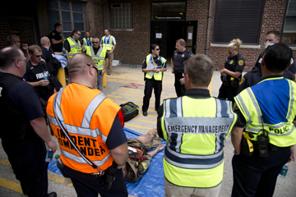
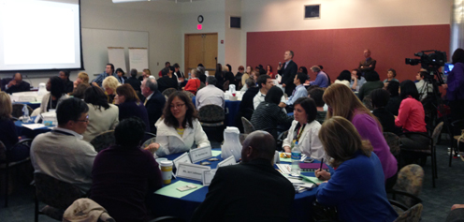
Types of Exercises

Slide 15
Exercise Complexity

Slide 16
Exercise Types
Discussion-Based Exercises
  Seminars
    Orientation to plans and procedures
  Workshops
    Similar to seminars;
    Interaction is increased;
    Focus on achieving or building a product
Notes:
Examples
Seminars
Good opportunity to review new policies or procedures
Familiarize team members with plans and emergency response
Roles and responsibilities of team members
NYSDOH Burn Plan
Workshops
Producing a plan or policy
Particular to the facility - evacuation; shelter-in-place plan

Slide 17
Exercise Types
Discussion-Based Exercises
  Tabletop Exercises
    Used to generate discussion of issues regarding an emergency
    Can be used to enhance awareness, validate plans and procedures
  Games
    Simulations involving teams
    Explores consequences of player decisions and actions
Notes:
Examples
Informal, discussion among team members to discuss roles in an emergency and response to an emergency situation
Pan flu planning
Continuity of Operations Plan
Cybersecurity

Slide 18
Exercise Types
Operations-Based Exercises
  Drills
    Coordinated, supervised activity to validate a specific function or capability
    Perfecting a skill or procedure
  Functional
    Validates/evaluates capabilities, multiple functions, or interdependent groups of functions
    Realistic and real time activity driven with scenario and event updates
    Movement of personnel and equipment may be simulated
Notes:
Examples
Drill
IOC;
Call-down of staff;
Earthquake – drop, cover and hold on
Functional
HEC exercise
Coalition Surge Test - evacuation and placement of different types of patients
Exercise specific team members and procedures/resources (e.g., communications, notificians, equipment set-up)

Slide 19

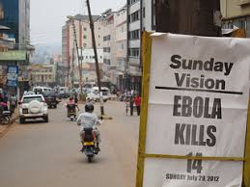


Exercise Types
Operations-Based Exercises
  Full Scale
    Most complex and resource intensive type
    Typically involves multiple agencies, organizations, and jurisdictions
    Validate many facets of preparedness
Notes:
Examples
Full Scale
As close to real event as possible
Takes place on location(s), using the personnel and equipment called upon in a real event
OUREx
POD exercises

Slide 20
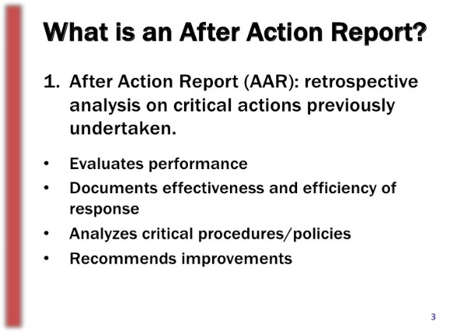
Evaluation and Documentation

Slide 21
Exercise Evaluation
Evaluation: The act of reviewing or observing and recording exercise activity or conduct
  Assesses behaviors or activities against objectives
  Notes strengths/weaknesses/deficiencies other observations/recommendations
Why Evaluate?
  Measure performance
  Improve plans and processes
  Documentation of exercise

Slide 22
After-Action Report/Improvement Plans
Document summarizing
  General exercise information and parameters
  Key information relative to the evaluation
  Completion of exercise objectives
  Analysis of capabilities
  Strengths and areas for improvement

Slide 23
Improvement Plan
Corrective actions identified from areas for improvement
  Responsible parties and timelines determined
  Tracked for completion
  Improvement plans
    Dynamic documents which are continually monitored and implemented as part of larger system of improving preparedness

Slide 24
More Detailed Information on Next Webinar on September 21, 2018
1:00 – 2:00 p.m.

Slide 25
Resources

Slide 26
National HPP Resource: TRACIE
Technical Resources
  Collection of preparedness materials searchable by keyword
Assistance Center
  Access to specialists for one-on-one support
Information Exchange
  Peer-to-peer, protected, open discussion
https://asprtracie.hhs.gov

Slide 27
Training Resources
New York State Department of Health
  Aware/Prepare Update
    To be included in the mailing list for the Aware Prepare Update, email edlearn@health.ny.gov

Slide 28
Testing Resources
Homeland Security Exercise and Evaluation
Program
  https://www.fema.gov/hseep
IS-120.A: An Introduction to Exercises - FEMA self-paced course
  Updated version and materials. Appropriate for all user levels https://emilms.fema.gov/IS120A/index.htm

Slide 29

Questions?
Patricia.anders@health.ny.gov

